Slide 1
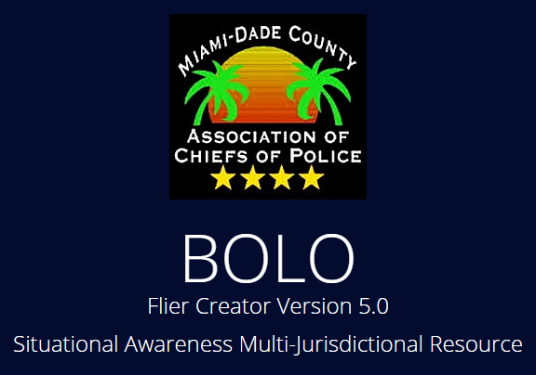



BOLO 5.0 Name: Jorge Medina
Team Member(s): John Burke, Nilton Munoz, Emmanuel Gonzalez, Jorge Medina Product Owner(s):Samuel Ceballos, Jason Cohen
Mentor(s): Juan Caraballo, Robert Loredo
Instructor: Masoud Sadjadi School of Computing and Information Sciences Florida International University
Senior Project Final Presentation
<Summer 2016>
August 5th, 2016
The logo of your project
Notes:
7 seconds.
Greet your audience, thank them for attending your presentation, introduce yourself, introduce your project, introduce your team members, and quickly indicate what each of you did in a high-level manner, and put more emphasis on your part/contribution.

Slide 2
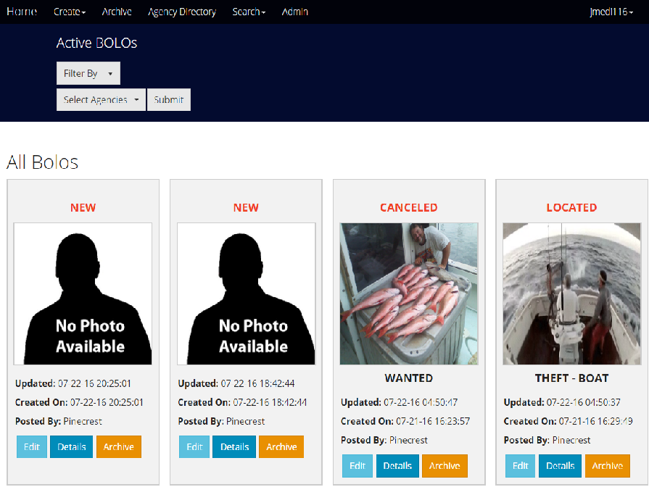
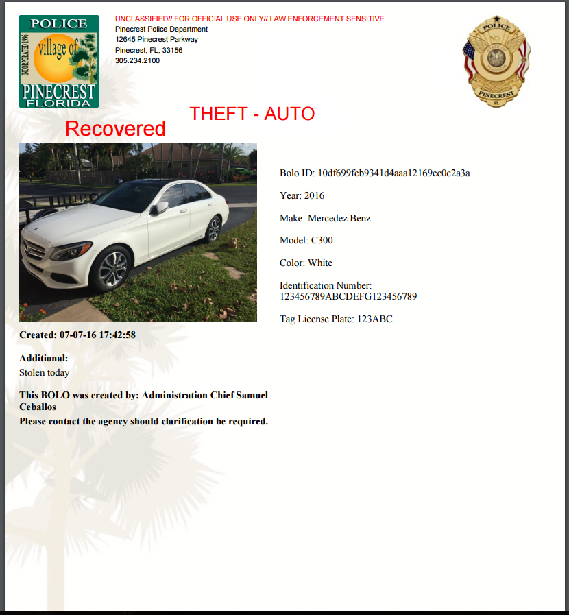
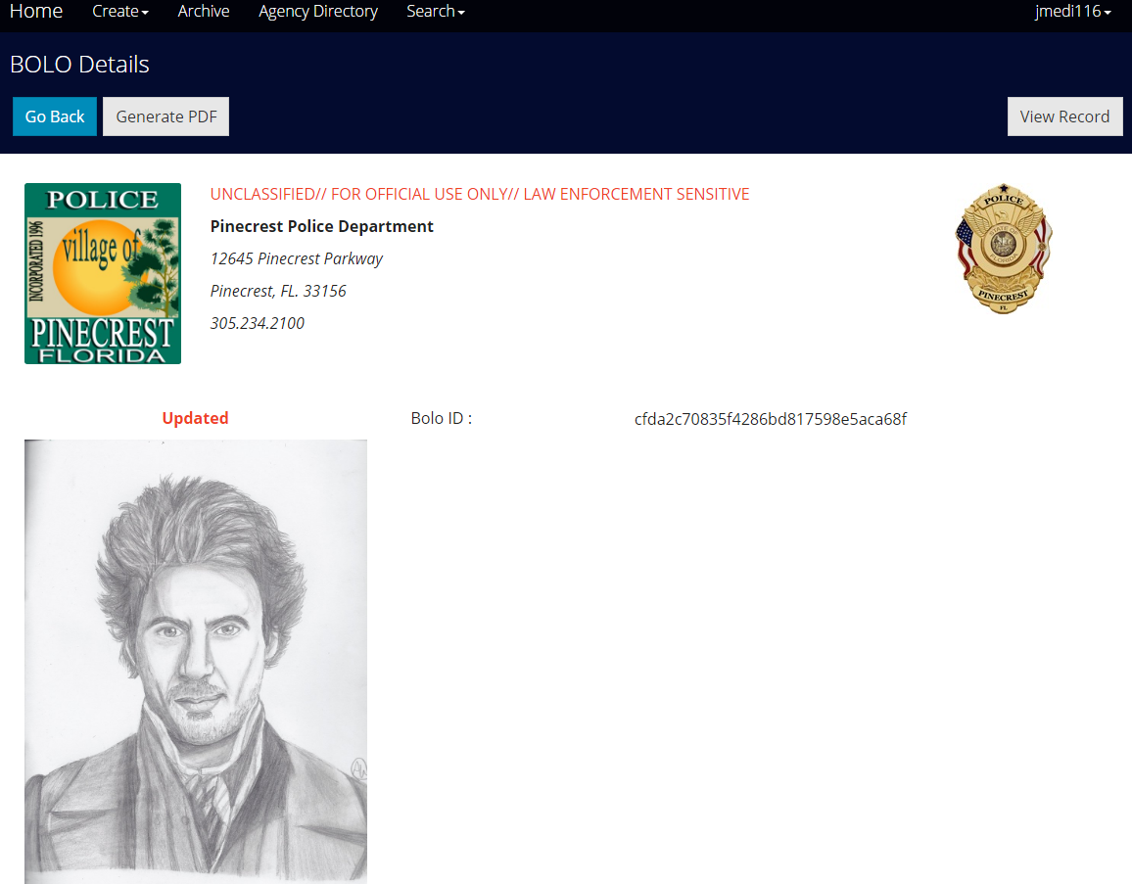
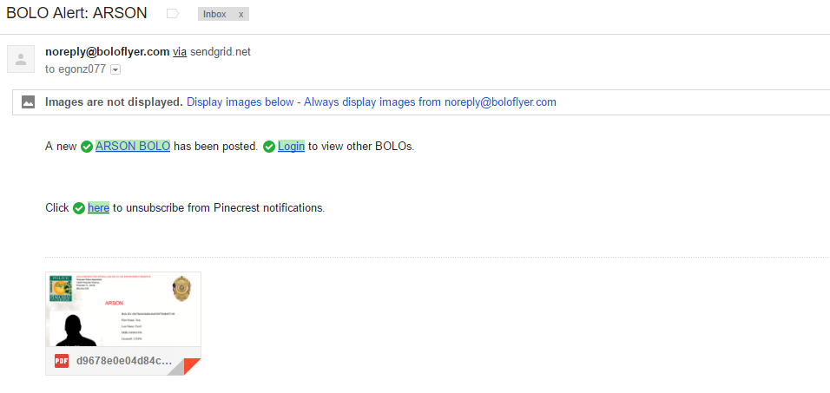
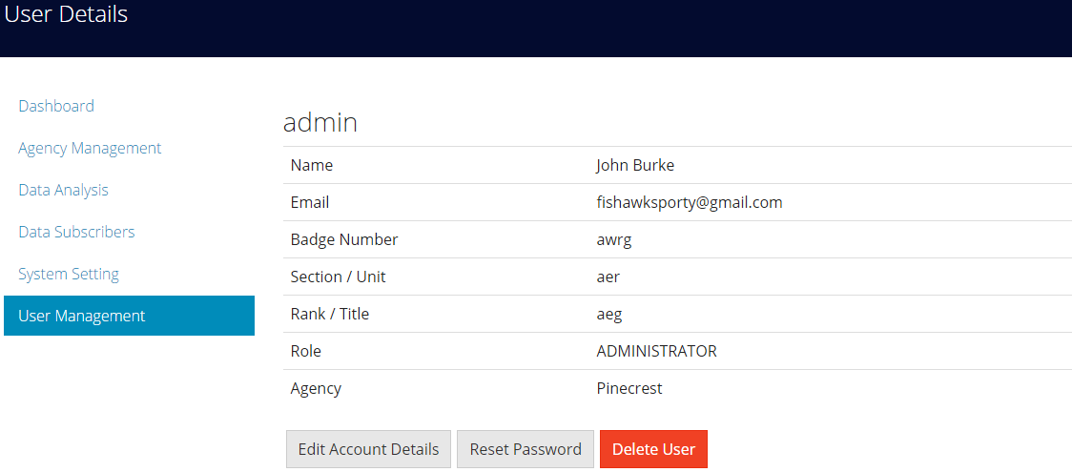
Project definition
Miami Dade County Police needs an application to efficiently create and distribute information about crime among all Agencies within Miami Dade County
Notes:
10 seconds.
Introduce the problem that the whole project (in all versions) tackles with GIF or screenshot.

Slide 3
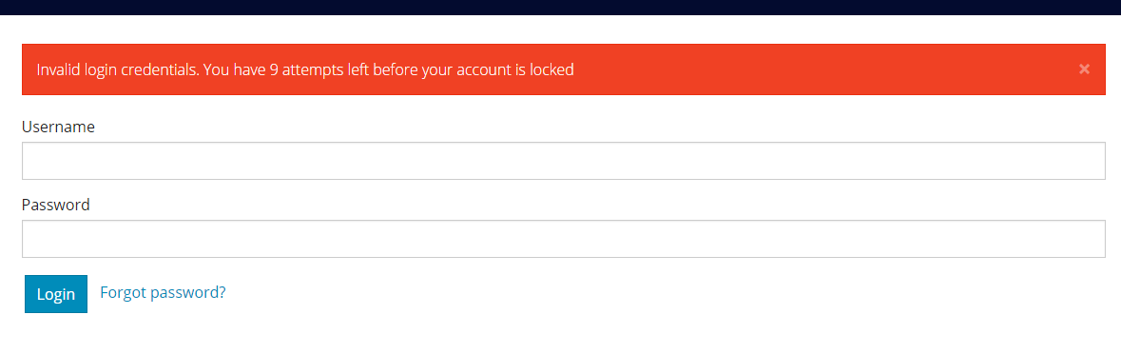
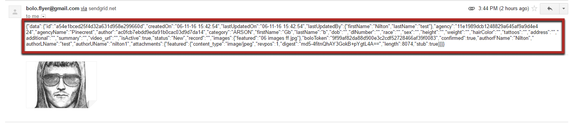
Project definition
BOLO 5.0 has added key functionalities to the project:
Security Enhancements:
Brute Force Prevention
SSL Enforcing
Session Timeout
BOLO confirmations
System Roles rules
Update DB Schema keeping data
Output of Data:
JSON feed to third party Agencies
CSV output for statistical analysis
Visual Enhancements:
Redesigned navigations
Watermarks for BOLO PDfs
Custom Templates
Templates for BOLO Theft and Auto Theft
Notes:
20 seconds.
Introduce the problem that the your project (in new version) tackles with GIF or screenshot.

Slide 4
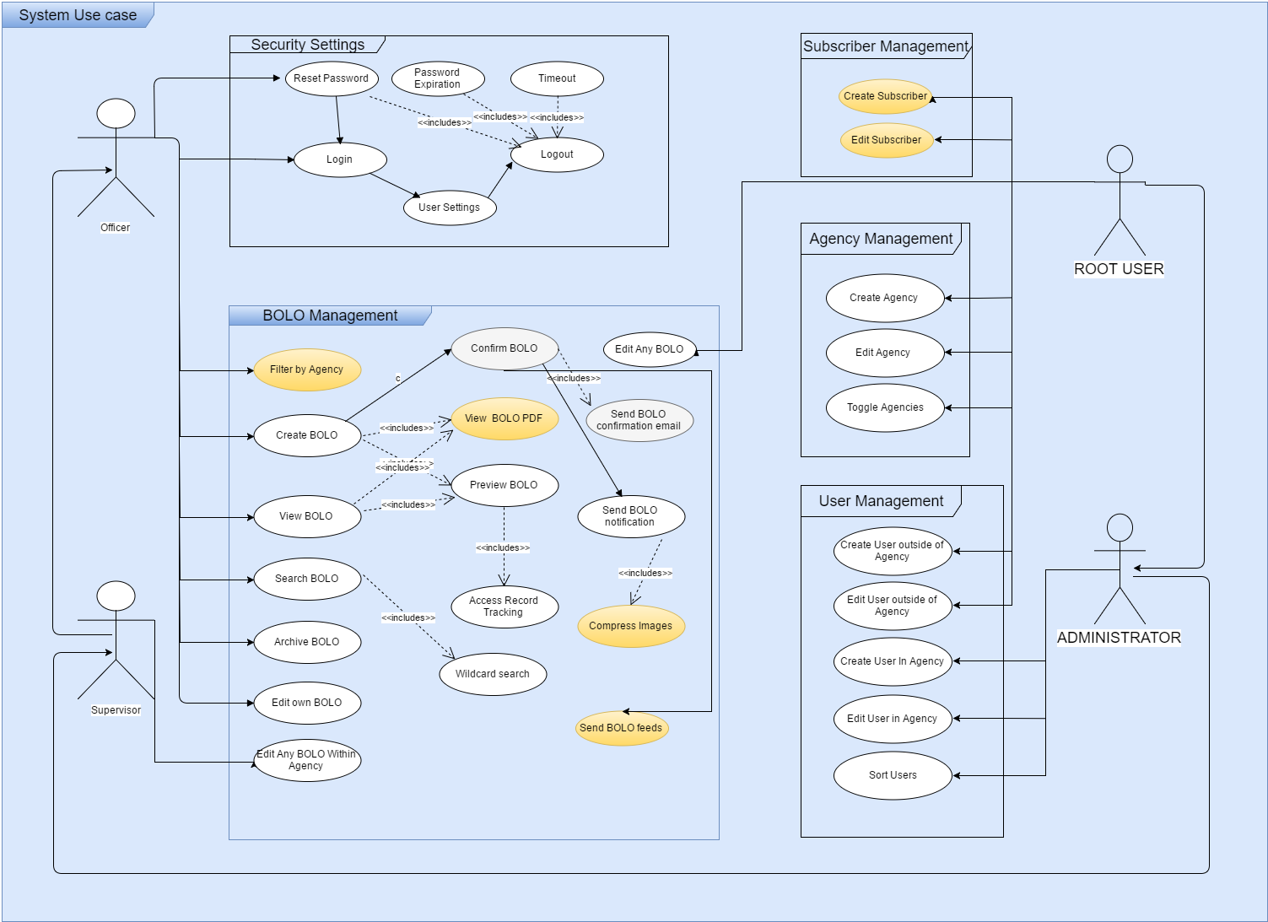
Requirements: Use Cases
Notes:
5 seconds
Show the Use Case Diagram for the whole project. Highlight your use cases.

Slide 5
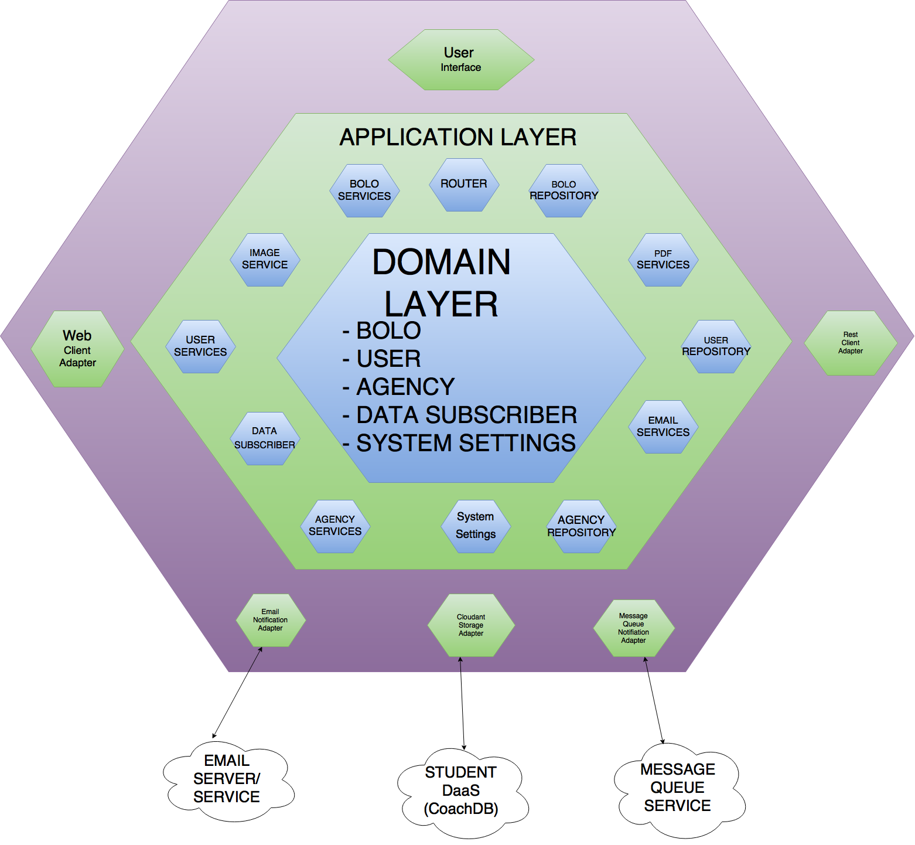
System Design: Architecture
Notes:
20 seconds
System design: Highlight the parts that you contributed to them.
1. System decomposition; identify the architecture patterns used
2. System deployment – h/w and s/w requirements

Slide 6
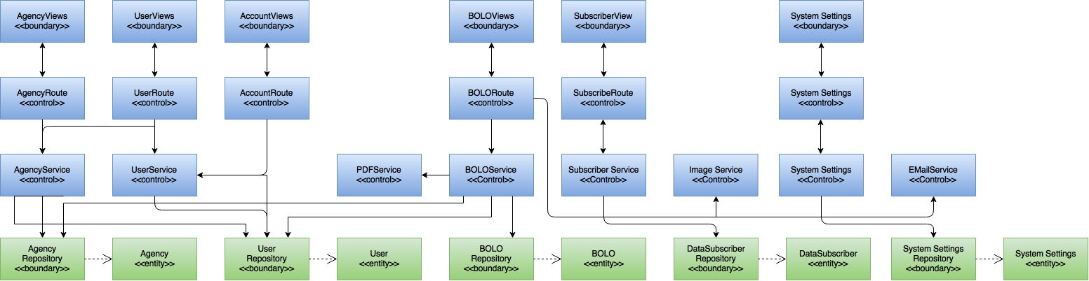
Minimal Class Diagram
Notes:
10 seconds.
Minimal class diagram. Highlight the classes that you created/modified
Identify the design patterns used (one or more slides).

Slide 7
User Stories
#1094. Bolo Updates Email Confirmation
#880. Bolo Feed to third party agencies
#931. Script to update database schema without dropping data
#920. Compression of Images
#986. Unsubscriptions from BOLO emails
#1037. Agency Settings access for Tier 3 users
#890. Watermark for Agencies
#1001. Routes Login redirection
Notes:
5 seconds.
List the user stories that you worked on them.(put in order of importance). Stay focused on the parts that you have been working.

Slide 8
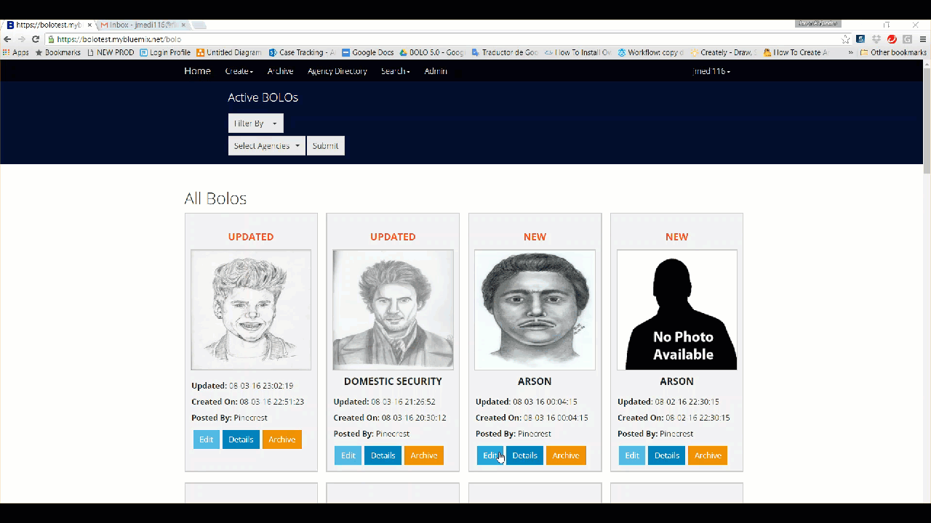
User Story #1094: Implement confirmation of BOLO updates - Flow of Events
Notes:
60 seconds
The tile of user story
The most important user story you worked on it. You have to describe this one very well and be proud of that.
Please present and show the complexity of your work, code, algorithms, and technical challenges and technologies you have used. (you could use screenshot if you want. Visual presentations are better than text presentation)
Go into the details of the most important/significant tasks using bullet lists or visual graphs or state chart diagram
Sequence Diagram for this user story is mandatory (in another separate page if required)
Demo using screenshots or GIF (in another separate page if required)

Slide 9
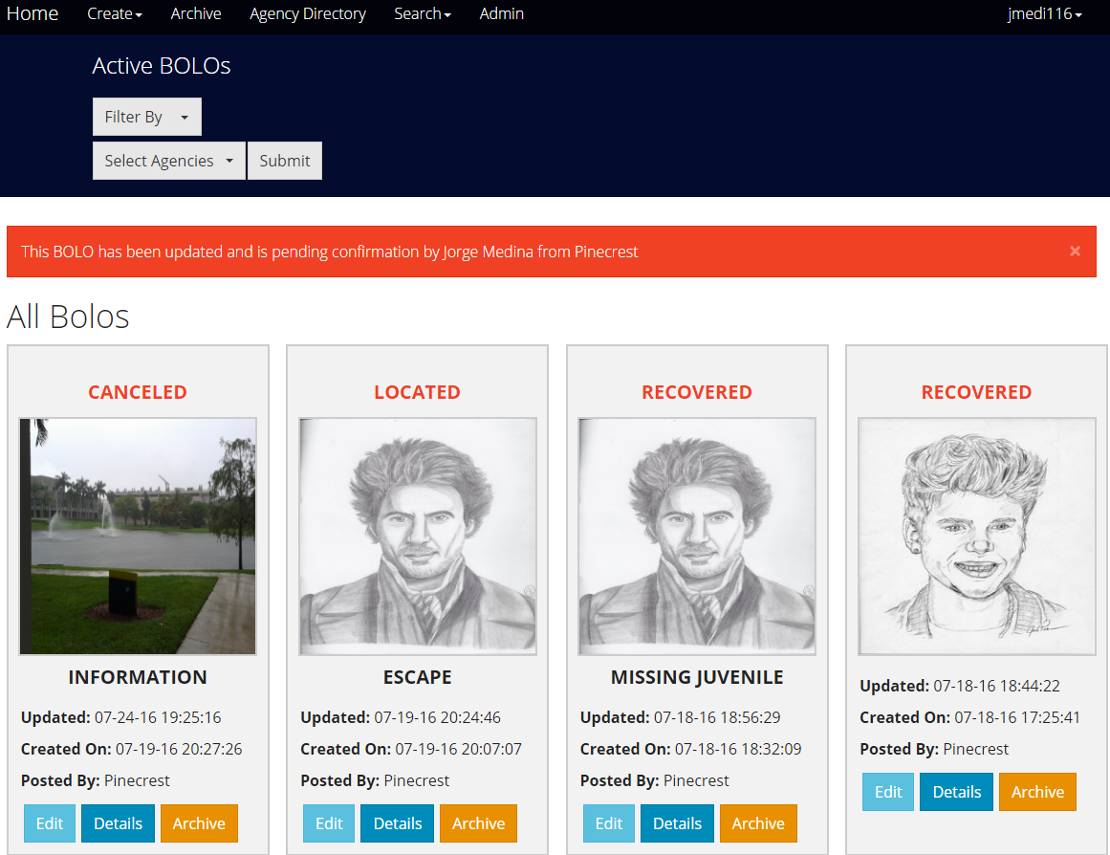
User Story #1094: Implement confirmation of BOLO updates - Versioning Control

Slide 10
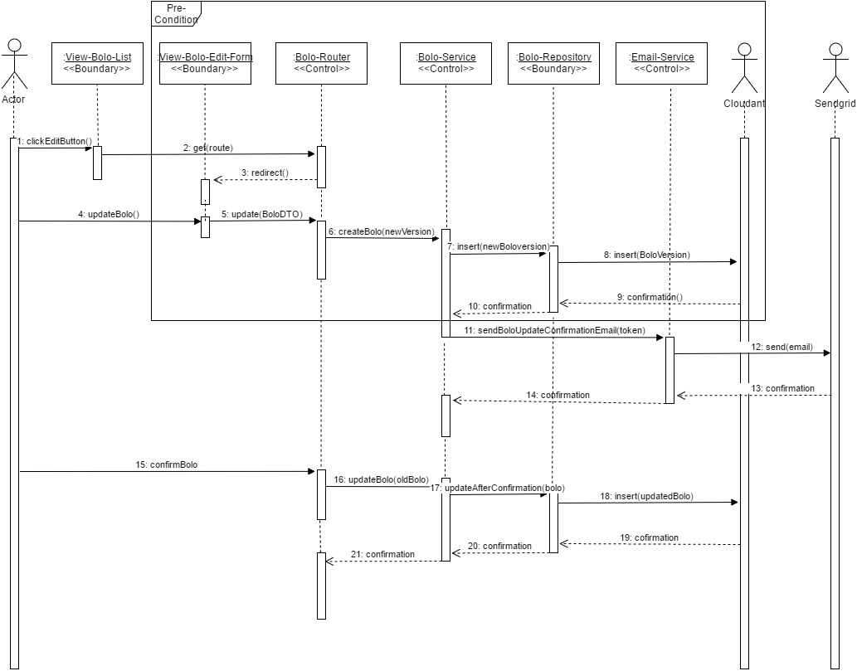
User Story #1094: Implement confirmation of BOLO updates - Sequence Diagram

Slide 11
User Story #880: Send feed BOLOs as JSON documents
Miami Dade County requires to receive the feed of all BOLOs
For all new BOLOs an email is sent to the subscribers with the BOLO as JSON (including attachments)
Notes:
20 seconds
The tile of user story
Please present and show the complexity of your work, code, algorithms, and technical challenges and technologies you have used. (you could use screenshot if you want. Visual presentations are better than text presentation) - Go into the details of the most important/significant tasks using bullet lists or visual graphs or state chart diagram - Demo using screenshots or GIF (in another separate page if required)
Sequence Diagram for this user story is optional

Slide 12
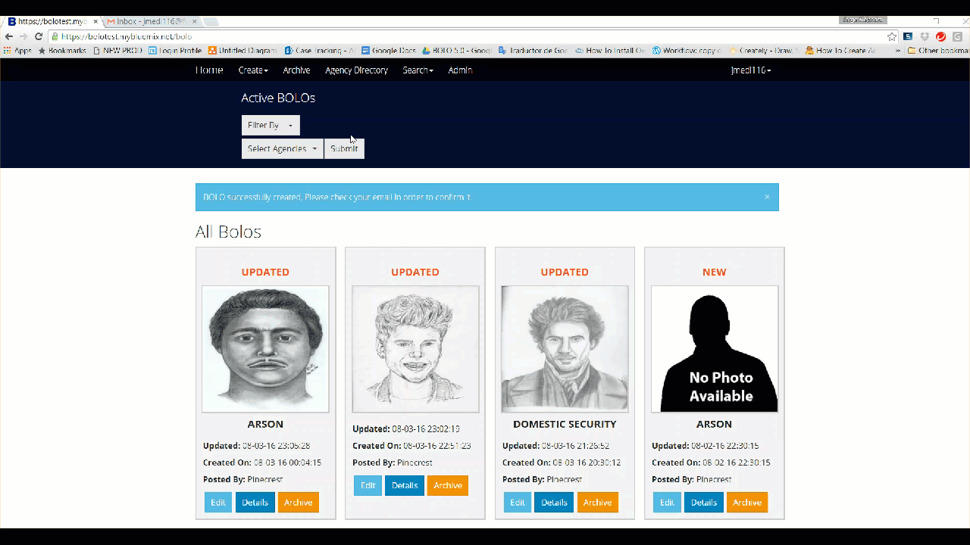
User Story #880: Send feed BOLOs as JSON documents

Slide 13
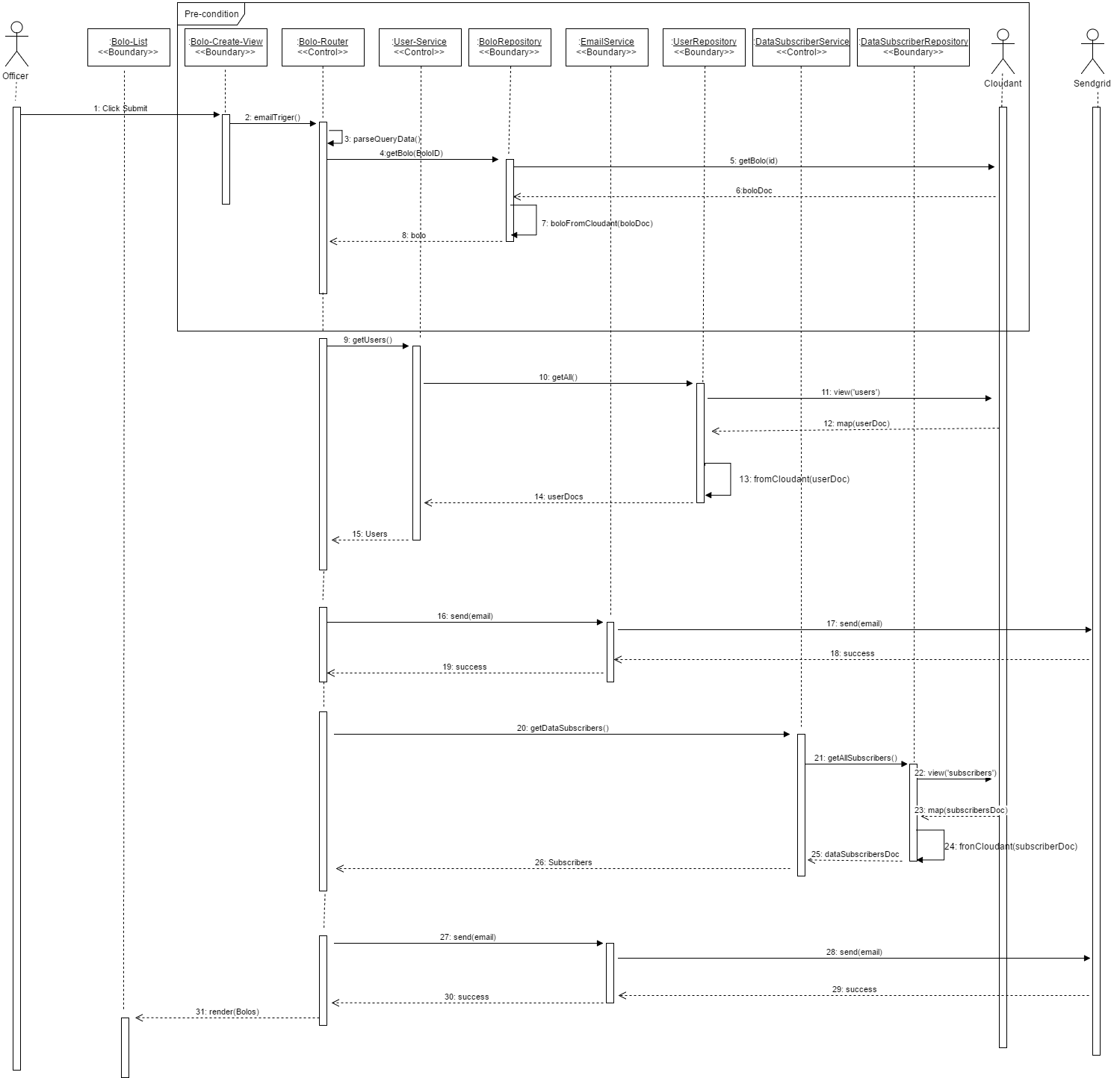
User Story #880: Send feed BOLOs as JSON documents - Sequence diagram

Slide 14
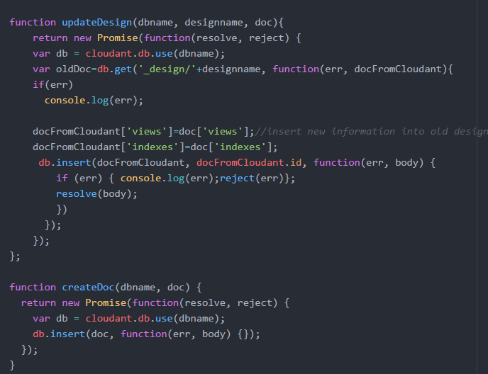

User Story #931: Create script to update DB Schema without dropping data
In previous releases data was lost every time DB design documents were updated
Developed script to add views and indexes to DB without reset
Notes:
20 seconds
The tile of user story
Please present and show the complexity of your work, code, algorithms, and technical challenges and technologies you have used. (you could use screenshot if you want. Visual presentations are better than text presentation) - Go into the details of the most important/significant tasks using bullet lists or visual graphs or state chart diagram - Demo using screenshots or GIF (in another separate page if required)
Sequence Diagram for this user story is optional

Slide 15
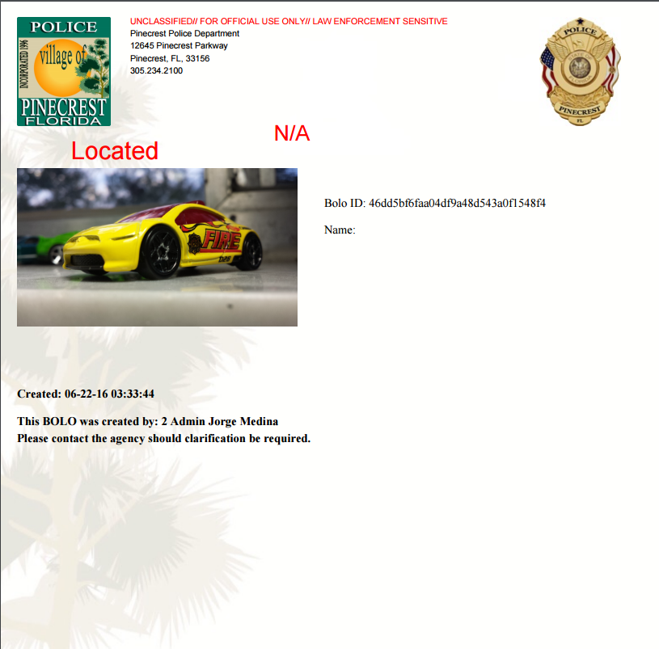
User Story #920: Compress all images upon upload
BOLO Flyers include images from Agencies and BOLOs, which add to the size of the PDF.
Typical Images are more than 4 Mb big, which will be sent to more than 3 thousand officers on the field
→ Increased cost of keeping the App running!!
Image Service compress images to less than 1 MB
Fast and efficient
Notes:
20 seconds
The tile of user story
Please present and show the complexity of your work, code, algorithms, and technical challenges and technologies you have used. (you could use screenshot if you want. Visual presentations are better than text presentation) - Go into the details of the most important/significant tasks using bullet lists or visual graphs or state chart diagram - Demo using screenshots or GIF (in another separate page if required)
Sequence Diagram for this user story is optional

Slide 16
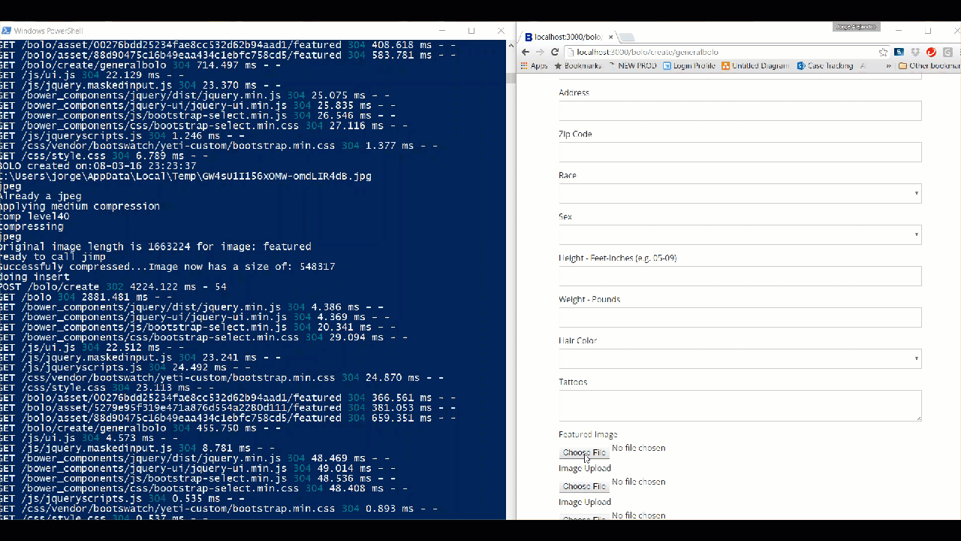
User Story #920: Compress all images upon upload

Slide 17
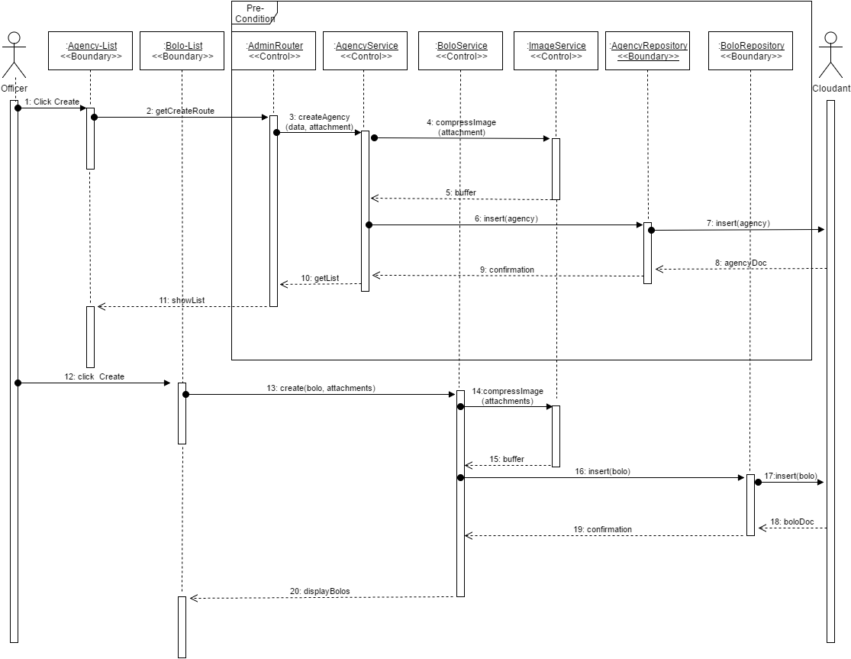
User Story #920: Compress all images upon upload - Sequence Diagram

Slide 18
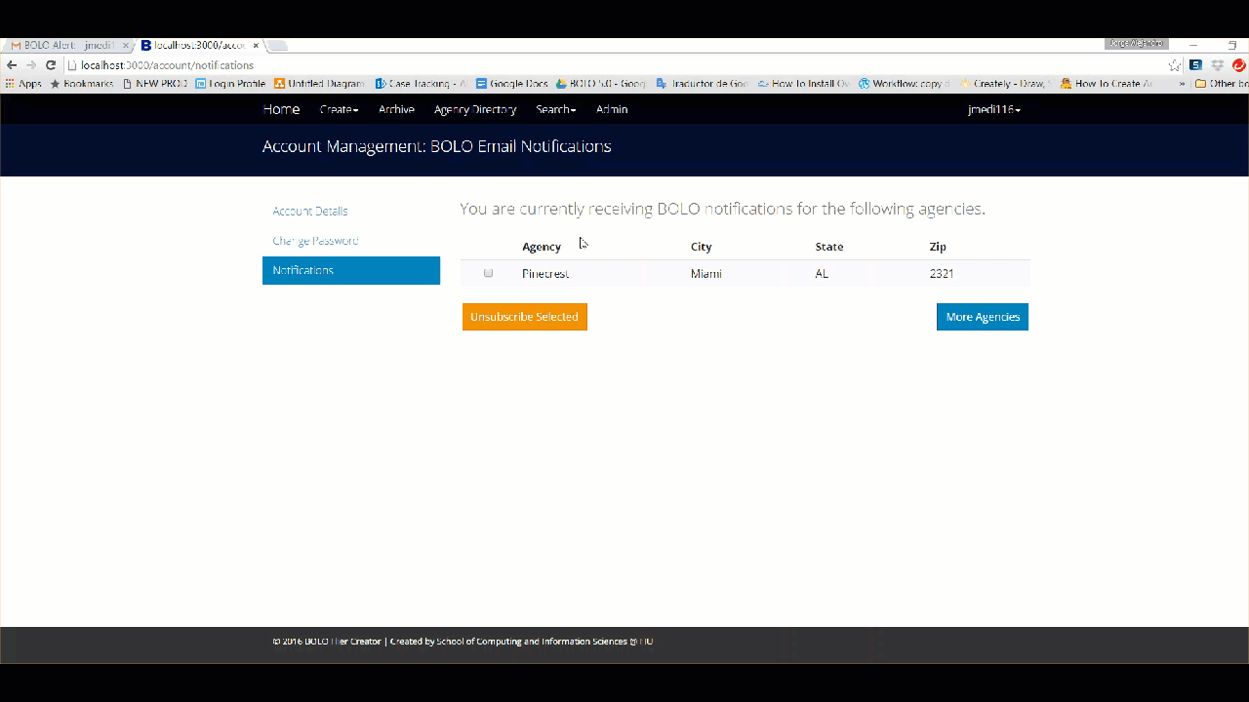
User Story #986: Unsubscriptions from BOLO emails
Users are able to unsubscribe from BOLOs from a particular agencies without having to navigate the Application.
Notes:
20 seconds
The tile of user story
Please present and show the complexity of your work, code, algorithms, and technical challenges and technologies you have used. (you could use screenshot if you want. Visual presentations are better than text presentation) - Go into the details of the most important/significant tasks using bullet lists or visual graphs or state chart diagram - Demo using screenshots or GIF (in another separate page if required)
Sequence Diagram for this user story is optional

Slide 19
Test Suites and Test Cases
ID: | U-1094-1 - Sunny Day
Purpose: | Validate that updates are applied when edits are confirmed
Preconditions: | testBolo exists in Database
Input: | Officer edits Bolo and email confirmation is sent by the System
Expected Output: | Bolo changes are shown when user cliks on confirmation link
ID: | U-1094-2 - Rainy Day
Purpose: | Validate that Bolo is locked for editing when it is pending confirmation
Preconditions: | TestBolo has been edited by testUser but is still pending confirmation.
Input: | test User2 tries to edit testBolo
Expected Output: | System displays message preventing testUser2 from updating testBolo.
Notes:
10 seconds
A description of verification process and Test Suites and Test Cases for one of the use cases.
1 One sunny day and one rainy day for the implemented use cases (one or more slides).
2 Automated test scripts for the implemented use cases (if any) (one or more slides).

Slide 20
Summary
Primarily worked on extended System services and Security settings
Contact Information:
Jorge Medina
(786) 879-4910
jmedi116@fiu.edu
linkedin.com/in/jorgejmr89
Thank you!!
Notes:
10 seconds
Summarize your contribution, mention your effort for Scrum, Mingle, Github, Google Drive Documentation and minutes
Include your contact information
Ask if anyone has any questions for you.
Thank your audience

Slide 21


Thank you!!!

